Slide 1
Covalent Bonding

Slide 2
Covalent Bonding

Slide 3
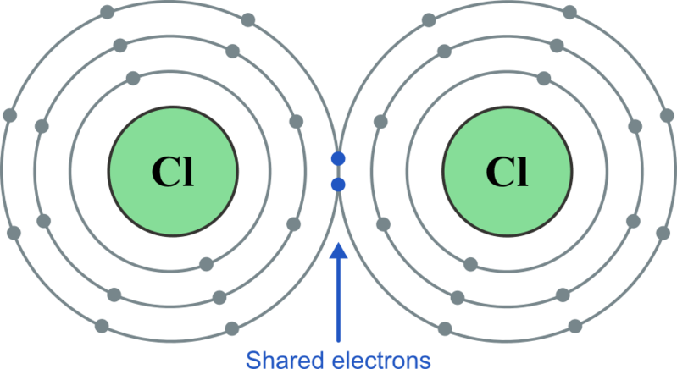
Atoms are most stable when they have full valence electron shells.
Non-metal atoms have lots of electrons in their valence shells already, so they need to gain electrons in order to fill their shells and become stable.
One way they can do this is by sharing electrons with other non-metal atoms. When two non-metal atoms share valence electrons, a covalent bond is formed.

Slide 4

Covalent bonds are held together by electrostatic attraction.
Electrostatic attraction is the attractive force between two particles with opposite electrical charges. When two atoms share electrons in a covalent bond, the positively charged nuclei of the atoms are attracted to the negatively charged electrons.
The electrostatic attraction is quite strong. Since neither atom wants to lose its now full valence shell, covalent bonds are strong and require a lot of energy to break.

Slide 5
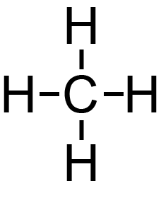

The number of covalent bonds an atom can form is known as the valency of the atom.
Valency is determined by the number of valence electrons required to fill the valence shell. Non-metals usually form the same number of covalent bonds as the number of valence electrons missing from their valence shells.

Slide 6
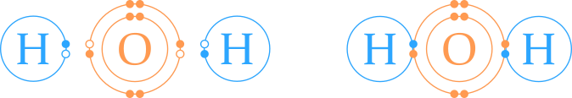
For example, water is a molecule made up of one oxygen atom and two hydrogen atoms, covalently bonded together.
Oxygen atoms have six valence electrons, and need two more to fill their valence shell. The valency of an oxygen atom is two.
Hydrogen atoms have one valence electron, and need one more to fill their valence shell. The valency of a hydrogen atom is one.
In water, an oxygen atom bonds to two hydrogen atoms, sharing one electron with each. This fills the valence shell of the oxygen atom and the hydrogen atoms. Since the valency of a hydrogen atom is one, they can only form one bond, so an oxygen atom must bond to two different hydrogen atoms in order to fill its valence shell and become stable.

Slide 7

Covalent bonds can be single, double, or triple bonds.
Atoms with a valency of greater than one can form multiple covalent bonds.
In a single covalent bond, each atom contributes one electron to the bond. Two electrons are shared between atoms.
For example, in a molecule of H₂​, two hydrogen atoms each share one electron with each other to form a single covalent bond.

Slide 8
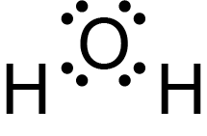

When four electrons are shared (i.e. two from each atom), a double covalent bond is formed.
For example, an oxygen atom has a valency of two. It can form two single covalent bonds, such as with two hydrogen atoms to form water. It can also form one double covalent bond, such as with another oxygen atom to form an oxygen molecule.
The dots show the arrangement of valence electrons around each atom. When the electrons are found between two atoms, this indicates they are involved in a covalent bond. Oxygen forms two single bonds in a water molecule (left), and one double bond in an oxygen molecule (right).

Slide 9
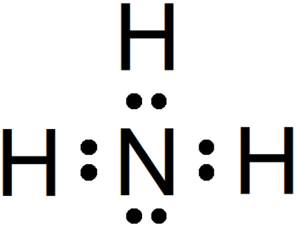

When six electrons are shared (i.e. three from each atom), a triple covalent bond is formed.
For example, nitrogen has a valency of three. It can form three single covalent bonds, such as with three hydrogen atoms to form ammonia. It can also form one triple covalent bond when it bonds with another nitrogen atom to form a nitrogen molecule, N₂​.
The dots show the arrangement of valence electrons around each atom. When the electrons are found between two atoms, this indicates they are involved in a covalent bond. Nitrogen forms three single covalent bonds in a molecule of ammonia (left). It forms one triple covalent bond in a molecule of nitrogen (right).

Slide 10
Electronegativity
In a covalent bond, the positively charged nuclei of the two atoms attract the negatively charged electrons that are shared between the atoms.
Not every type of atom attracts electrons to the same extent.
The tendency of a nucleus to attract bonding electrons is called electronegativity.

Slide 11
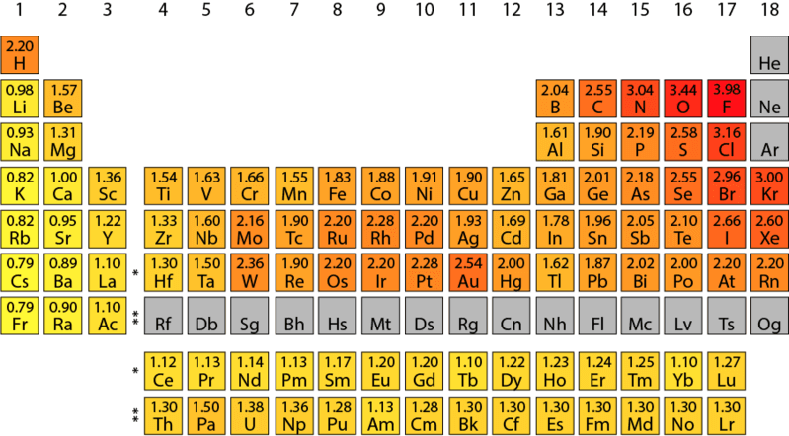
The more electronegative an element is, the more strongly it attracts electrons.
Electronegativity depends on several factors:
The number of protons in the nucleus.
The distance between the nucleus and the bonding electrons.
The most electronegative element is fluorine, which is found at the top right of the periodic table. The relative electronegativity of other elements decreases as you get further away from fluorine on the periodic table.

Slide 12
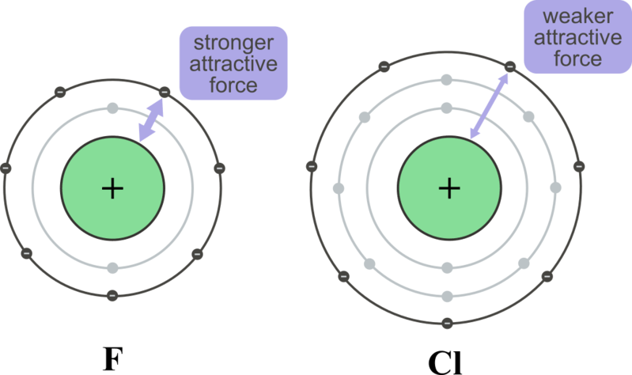
Trends in Electronegativity
In general, electronegativity shows the following trends:
It increases across a period.
It decreases down a group.
Elements in the same period have the same number of electron shells (energy levels), but the number of protons in the nucleus increases across the period. This means that the electrostatic attraction between the protons and electrons becomes stronger as you move from left to right across a period.
As you move down a group, the number of electron shells increases, which increases the distance between the nucleus and the valence electrons. This distance is known as the atomic radius. As the atomic radius gets larger, the electrostatic attraction between the protons in the nucleus and the valence electrons becomes weaker.

Slide 13
Non-polar Bonds
When the two non-metal atoms in a covalent bond have the same electronegativity, they attract the electron density to the same extent. This means the negative charge of the bonding electrons will be equally distributed across both atoms.
The position of the shared electrons can be described as the electron density.
The resulting covalent bond is called non-polar, because there is no separation of charge density.
Non-polar bonds form when two atoms of the same element bond together, such as two hydrogen atoms bonding to form H₂​. They can also form when the difference in electronegativity between two atoms is small enough that the electron density is not pulled significantly closer to one or the other atom. For example, a C−H bond is considered non-polar because the electronegativity difference between carbon and hydrogen is very small (less than 0.40 on the Pauling scale).

Slide 14
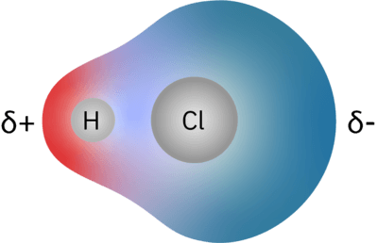
Polar Bonds
When one of the atoms in a covalent bond is more electronegative than the other, this atom has a stronger attraction for the electron density in the bond. This will cause the electron density to sit closer to the more electronegative atom, making it unevenly distributed within the bond. This is known as a polar bond.
In a polar bond, the more electronegative atom will gain a slightly negative charge (denoted by δ−). The less electronegative atom will gain a slightly positive charge (denoted by δ+) as the negative charge is being pulled away from it.
In an H-Cl bond, the electron density sits much closer to the chlorine atom than the hydrogen atom. The area of high electron density is shown in blue and the area of low electron density is shown in red.

Slide 15
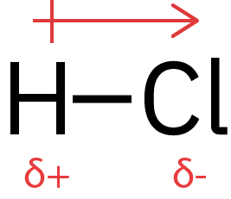
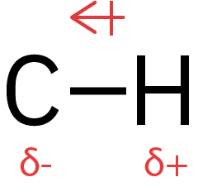
The separation of charge in a polar bond creates an electric dipole, known as the bond dipole.
Bond dipoles are vector quantities, so can be represented using arrows.
A vector quantity has both magnitude and direction.
The bond dipole arrow always points from the positive end to the negative end. A positive symbol, +,+, is placed at the tail of the arrow to show that this is the positive end.
Different bonds will have differently sized bond dipoles. The larger the difference in electronegativity, the larger the bond dipole, and the longer the arrow used to represent it.
The difference in electronegativity between H and Cl is much greater than the difference in electronegativity between H and C. Therefore, the bond dipole arrow for the H-Cl bond is longer than the arrow for the C-H bond. A C-H bond is actually typically considered non-polar, because the electronegativity difference is less than 0.4 on the Pauling scale.

Slide 16
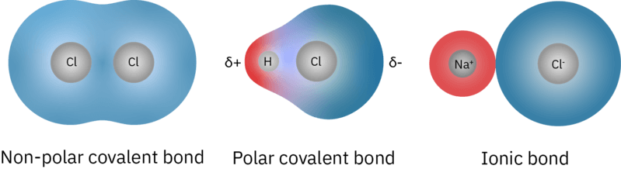
When the electric dipole between two atoms is very large, the bond begins to gain ionic character.
In an ionic bond, the electrons can be thought of as being completely donated from one atom to the other, forming a positively charged ion and a negatively charged ion.
Typically, covalent bonds are formed between two non-metal atoms. Ionic bonds are formed between a metal atom and a non-metal atom, as the non-metal atom has much greater electronegativity than the metal atom.
In reality, the distinction between ionic and polar covalent bonds is a continuum, and a bond is "ionic" if its ionic character is greater than its covalent character. Where a bond falls within this continuum depends on the difference in electronegativity between the two atoms.

Slide 17
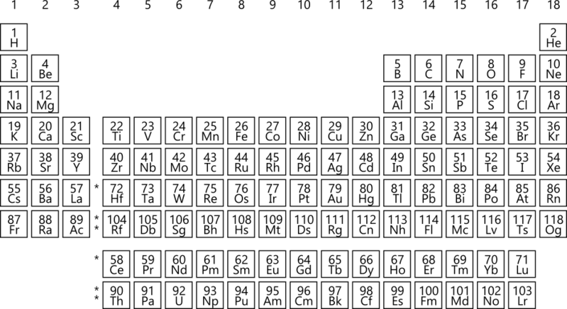
Predicting bond polarities
You will not usually be given electronegativity values. You’ll need to be able to look at the position of the two elements on a regular periodic table to determine their relative electronegativities and the polarity of the bond.
The element that is closer to fluorine on the periodic table will have the greater electronegativity.
However, you will also be given examples that avoid the grey areas and are clearly polar or non-polar. You can predict that if the bond involves two identical non-metal atoms, it is non-polar covalent; if it involves two different non-metal atoms, it is polar covalent; and if it involves a non-metal and a metal it is ionic.

Slide 18
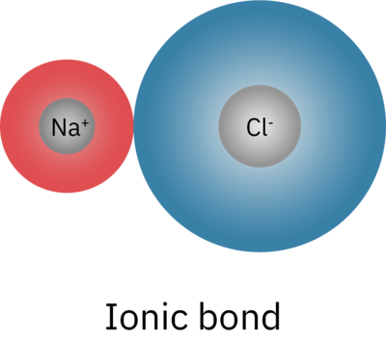
Polar and Non-polar Covalent Bonds: A Summary
Particles of opposite charge have an electrostatic attraction. A particle with a positive charge, e.g. Na, and a particle with a negative charge, e.g. Cl, will be attracted to each other and will form an ionic bond.
Electrons can be shared between two atoms. The electron from one atom will be attracted to the nucleus of the other atom. The sharing of electrons forms a covalent bond.
Covalent bonds can be polar or non-polar, depending on how high the electronegativity is. If the electronegativity isn't high enough to cause ionisation, instead of an electron being stolen, it's shared unevenly in favour of the more electronegative atom in a polar covalent bond. The atom with the electron closest to it is partially negative (denoted by δ−). The atom with the electron being pulled away is partially positive (δ+). In non-polar covalent bonds electrons are shared evenly with both atoms having no partial charges.
We can predict the type of bond by comparing electronegativities. If the difference in electronegativity is very low it will be a non-polar covalent bond. If the difference is quite large, the bond will be an ionic bond.

Slide 19
Physical Properties of Molecular Substances

Slide 20
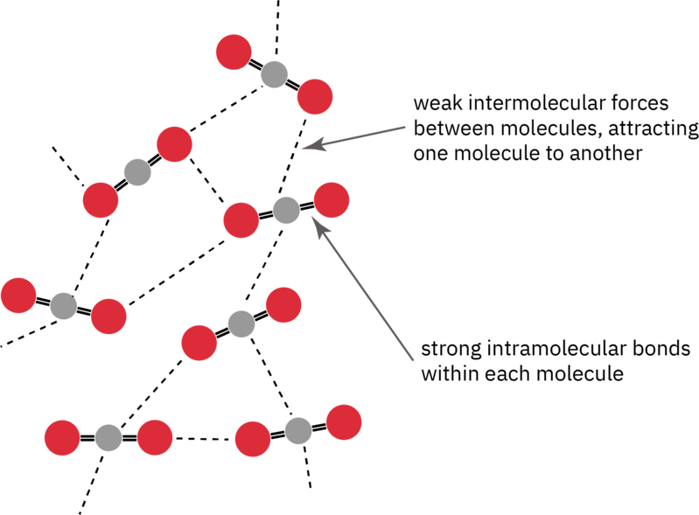
Molecular substances are made up of discrete molecules bound together by covalent bonds.
The intermolecular forces holding these molecules together are weak compared to the intramolecular forces (covalent bonds) within each molecule.
Intermolecular forces are the forces between individual molecules.
Intramolecular forces are the forces within a molecule; the covalent bonds between atoms.
The strength of the intermolecular forces is dependent on whether the molecule has a permanent dipole or not (whether it is polar or non-polar), with polar molecules having stronger intermolecular forces than non-polar molecules in general.

Slide 21
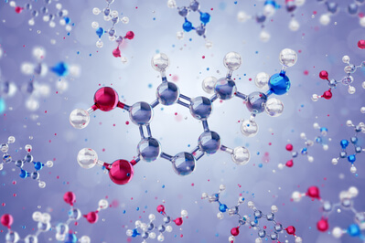
Remember that there are three main types of intermolecular forces found within molecular substances.
Dispersion forces: These arise from the movement of electrons within a molecule creating a temporary dipole. These instantaneous dipoles are electrostatically attracted to the oppositely charged dipoles of neighbouring molecules. These are the weakest type of intermolecular force.
Dipole-dipole forces: In polar molecules, the more electronegative atoms draw more electron density towards them, creating a permanent dipole within the molecule. These permanent dipoles are electrostatically attracted to the opposite dipole on neighbouring molecules.
Hydrogen bonding: This a special type of dipole-dipole force that can occur in molecules with hydrogen atoms covalently bound to either fluorine, oxygen or nitrogen. This allows for strong electrostatic attractions to occur between the large partially positive charge on the hydrogen atom, to the partial negative charges of neighbouring molecules.

Slide 22
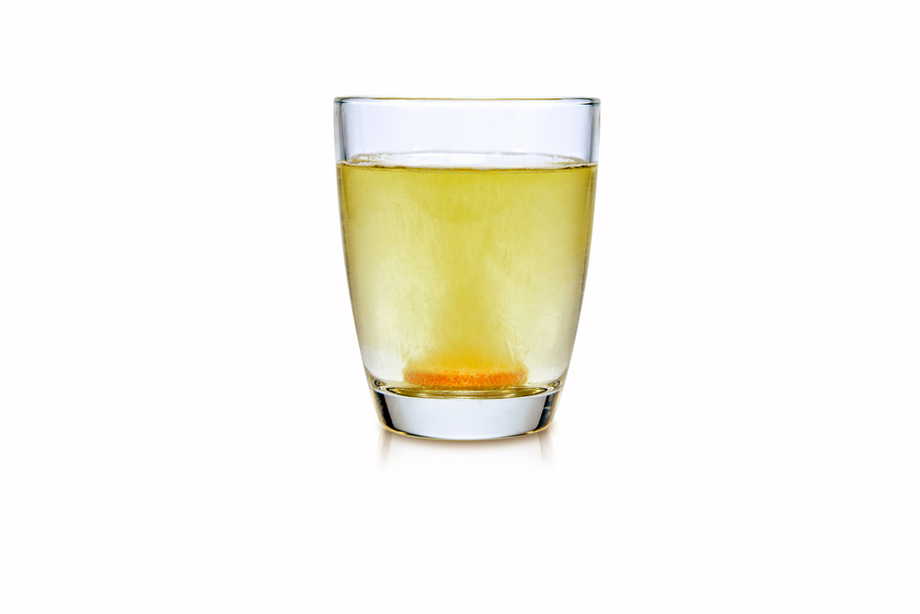
When a substance dissolves in another, it forms a solution.
A solution consists of two things:
A solvent: The substance (usually a liquid) that dissolves the other substance. This is present in greater amounts, allowing the other substance’s particles to fit between the solvent particles.
A solute: The substance being dissolved.
A solvent dissolves a solute in two steps:
The intermolecular forces between the solvent molecules and between the solute particles are broken.
New intermolecular attractions form between the solvent molecules and solute molecules.

Slide 23
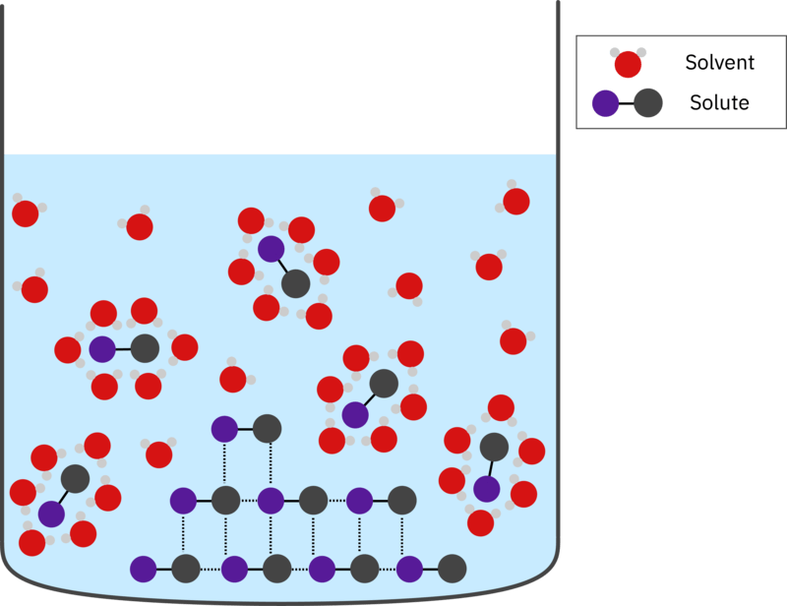
Whether a substance will dissolve in another substance is dependent on the type and strength of the intermolecular forces present within the two substances.
If the solute-solute and solvent-solvent intermolecular forces are stronger than the potential solute-solvent intermolecular forces, then the solute will not dissolve. However, if the potential solute-solvent intermolecular forces are similar or stronger, then the solute will dissolve.
This is because it must be energetically favourable for both the solute and solvent to break their intermolecular forces, and form new intermolecular forces between one another. If the new intermolecular forces formed are weaker, it will require less energy to overcome these forces and they will be energetically unfavourable.
A handy rule of thumb is “like dissolves like”. Polar substances will dissolve in polar solvents and non-polar substances will dissolve in non-polar solvents in general.

Slide 24
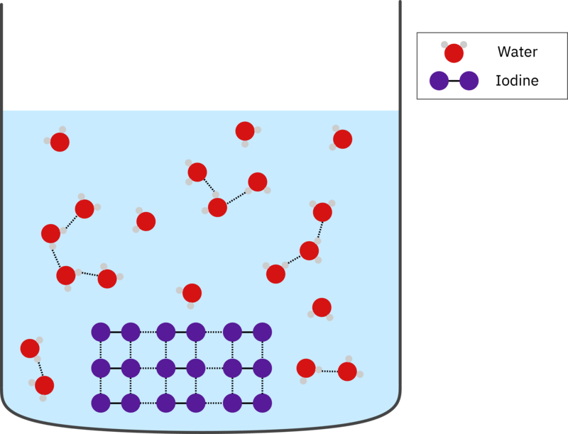
If the intermolecular forces are of very differing strengths, the substances will be insoluble.
This means that polar substances, which contain stronger intermolecular forces, will not dissolve in non-polar substances and non-polar substances will not dissolve in polar substances.
An example of this is trying to dissolve iodine (I₂​) in water. The iodine will not dissolve in the water and remain as a separate solid. The intermolecular forces within the non-polar iodine are just dispersion forces, while the water contains much stronger hydrogen bonds.
It is not energetically favourable for the water to dissolve the iodine. For the iodine and water to mix, the strong hydrogen bonds between the water molecules would need to be broken and weaker dispersion forces would form between the water and iodine molecules. The water will be less stable if it forms these weaker water-iodine forces, as it will require less energy input to break these compared to the water-water hydrogen bonds.

Slide 25
If a solvent and a liquid solute cannot form new intermolecular attractions between one another, they will be insoluble and will remain in separate layers.
A common example of this can be seen when cooking oil and water are mixed. The non-polar oil molecules and the polar water molecules are unable to form new intermolecular attractions with one another due to the differences in their intermolecular forces.
The cooking oil molecules are held together by dispersion forces, while the water molecules are held together by hydrogen bonding. It is energetically unfavourable for water-oil intermolecular attractions to form, causing the oil and water to remain in separate layers.

Slide 26
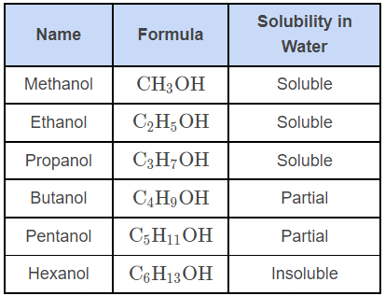
Molecules can contain both non-polar and polar constituents, and this affects their solubility.
An example of this is alcohol molecules, such as ethanol and hexanol. Their solubility in water is shown in the table below. As the length of the carbon chain increases, the solubility of the alcohol is reduced.
Ethanol is soluble in both polar and non-polar solvents, as it has a small non-polar chain, and also an -−OH group. This -\text{OH}−OH group allows it to easily form hydrogen bonds with the polar solvent molecules it is dissolving into, while its C₂​H₅​ group allows it to form dispersion attractive forces with non-polar solvents.
Hexanol has a comparatively larger non-polar chain, and the dispersion forces are much larger. It is energetically unfavourable for polar solvents to break their polar intermolecular forces to associate with molecules of hexanol. This means that hexanol will not dissolve in polar solvents, despite having the same -−OH group as ethanol.

Slide 27
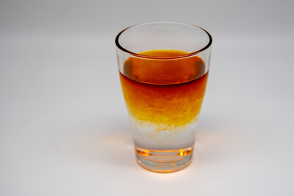
These polar and non-polar constituents not only affect a molecule’s solubility but also its ability to act as a solvent.
Ethanol can act as a polar solvent due to the presence of the −OH group, allowing it to hydrogen bond to other polar molecules. This allows polar substances such as glucose (C₆​H₁₂​O₆​) to dissolve in ethanol.
However, ethanol can also act as a non-polar solvent due to the non-polar −C₂​H₅​ group, which allows it to form dispersion force attractions with non-polar molecules.
This causes non-polar substances such as iodine (I_{2​}) to be much more soluble in ethanol than in water.

Slide 28

Evaporation, which is the process of a liquid becoming a gas, occurs at the surface of the liquid.
When the particles at the surface of the liquid have enough kinetic energy to overcome the intermolecular forces between them, they can ‘escape’ the bulk liquid and become gaseous.
The stronger the intermolecular forces, the more kinetic energy a molecule must possess in order to break away as a gas.

Slide 29
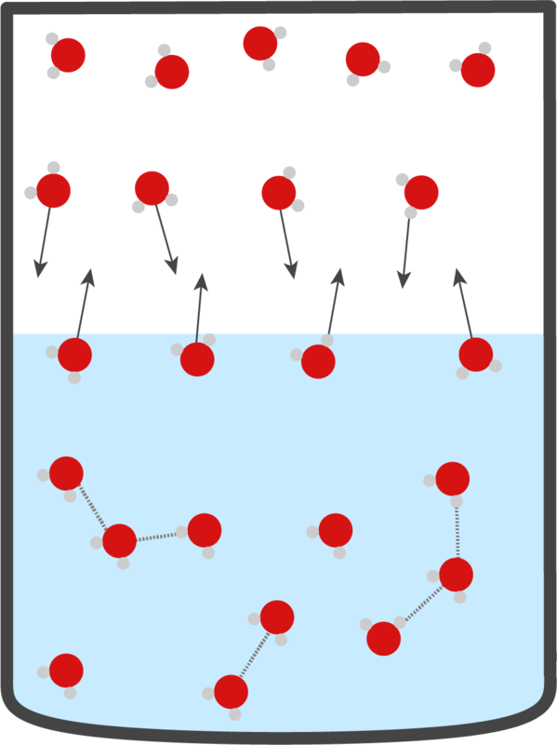
When a liquid is in a closed container, the particles that escape the liquid are moving around in the space above the liquid.
These particles will collide with the container walls and with the surface of the liquid. Some of the particles that collide with the surface of the liquid will re-form bonds with the particles in the liquid and condense.
Over time, an equilibrium is reached where the rate of evaporation is equal to the rate of condensation.
Once equilibrium is reached, there is no change in the amount of gas particles within the container. This creates a constant pressure that is exerted on the container walls by the gaseous particles, which is known as the vapour pressure.

Slide 30
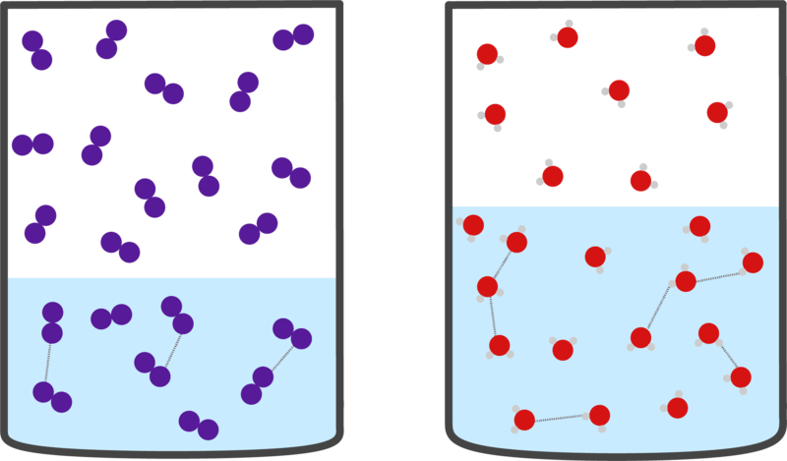
The vapour pressure of a liquid depends on the strength of the intermolecular forces within the liquid.
Liquids with strong intermolecular forces will have lower vapour pressures, as fewer particles have enough kinetic energy to overcome those forces and enter the gas phase.
Conversely, liquids with weak intermolecular forces will have high vapour pressures, as it is easy for particles to gain enough kinetic energy to overcome the intermolecular forces and enter the gas phase.
In the example below, a non-polar liquid (iodine) and polar liquid (water) are shown. Because iodine has weaker intermolecular forces, it will have more molecules in the gas phase compared to water. This means that iodine would have a higher vapour pressure than water, as there are more gaseous molecules exerting pressure on the container.

Slide 31

Vapour pressure increases with temperature, as more and more particles gain enough kinetic energy to overcome the intermolecular forces within the liquid.
When the vapour pressure of a liquid becomes equal to the atmospheric pressure of its surroundings, it begins to boil. The temperature at which vapour pressure becomes equal to the atmospheric pressure is known as the boiling point.
This allows molecules to enter the gaseous state from anywhere in the bulk liquid, not just the surface, which is why bubbles form in a boiling liquid.

Slide 32
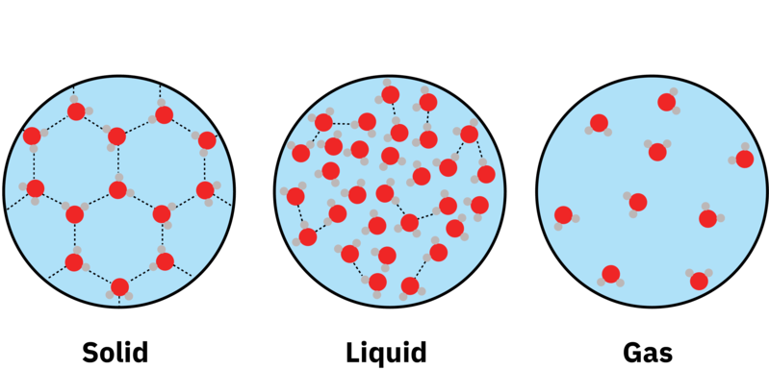
The intermolecular forces in molecular substances are weak compared to other substances such as ionic or metallic substances.
These intermolecular forces require lower energy input to break, and due to this, molecular substances tend to have lower melting and boiling points.
At the melting point, enough intermolecular forces are broken between molecules to allow them to become a liquid. At the boiling point, all intermolecular forces are broken between molecules, allowing them to become gaseous.
When water is solid, there are many intermolecular forces between the molecules (shown by the dotted lines), holding them in place. When it melts, some of the intermolecular forces break, allowing the water molecules to move around more. Once water becomes a gas, all intermolecular forces are broken and the molecules are completely free to move.

Slide 33
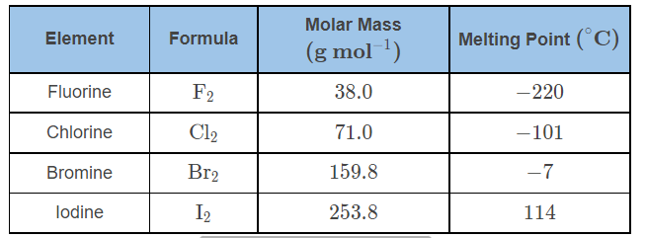
Molecular substances that are non-polar will only have dispersion forces.
These are the weakest kind of intermolecular force, and will result in molecules with the lowest melting and boiling points.
Dispersion forces increase with molar mass, as the molecule has larger electron clouds and thus greater temporary dipoles. Molecules with similar molar masses can have different numbers of electrons. The molecule with more electrons will be more polarisable and thus have greater dispersion forces.
Polarisablility is the measure of how easily a temporary dipole can be induced within a molecule.
This means that non-polar substances will have increasing melting and boiling points as their mass increases, as seen with the Group 17 elemental substances.

Slide 34
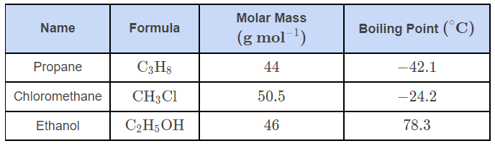
The molecular substances with the highest melting and boiling points are those capable of hydrogen bonding.
Hydrogen bonding is the strongest type of intermolecular force, and only occurs in molecules which have a hydrogen atom bound to a fluorine, oxygen or nitrogen atom. This strength is due to the high electrostatic attractions between the large slightly positive charge (δ+) on the hydrogen atom and the lone pair of electrons present on the fluorine, oxygen or nitrogen of neighbouring molecules.
This can be seen by comparing the boiling points of different organic substances of comparable molar mass. The non-polar molecule, C₃​H₈​, has the lowest boiling point, whilst the polar molecule, CH₃​Cl, has a much higher one. C₂​H₅​OH has the largest boiling point by a significant margin, due to its ability to hydrogen bond.

Slide 35
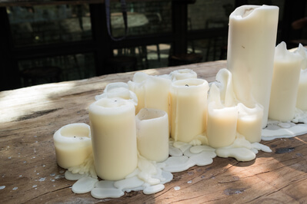
If a molecular substance can exist as a solid, it will be soft and can easily be scratched or broken apart.
The characteristic softness of molecular substances is due to the weak intermolecular forces between the molecules. Remember that these forces are much weaker than the intramolecular forces holding the molecules themselves together.
Softness is the measure of how easily a solid substance can be scratched/marked.
When force is applied to the solid substance, these forces are easily overcome, allowing the surface to be easily scratched or deformed as the molecules can be moved out of their position within the solid lattice.

